Slide 1
Control structures
Zainab Shahzadi

Slide 2
Control Structures
A computer can proceed:
In sequence
Selectively (branch): making a choice
Repetitively (iteratively): looping
Some statements are executed only if certain conditions are met
A condition is met if it evaluates to true

Slide 3
Control Structures (cont'd.)

Slide 4
One-Way Selection (cont'd.)
Notes:
Remember flow charts

Slide 5
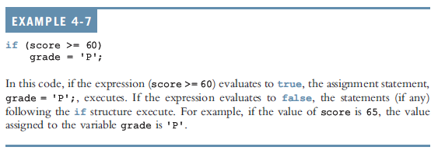
One-Way Selection (cont'd.)

Slide 6
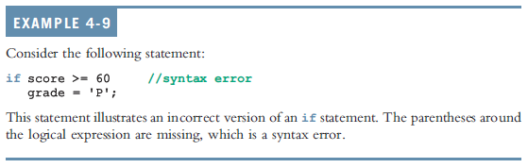
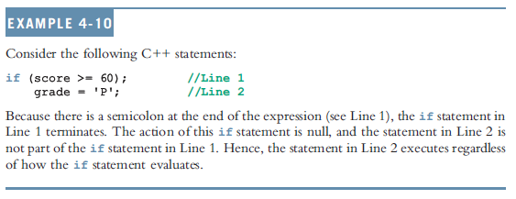
One-Way Selection (cont'd.)

Slide 7
Two-Way Selection
Two-way selection takes the form:
If expression is true, statement1 is executed; otherwise, statement2 is executed
statement1 and statement2 are any C++ statements
else is a reserved word

Slide 8
Two-Way Selection (cont'd.)

Slide 9
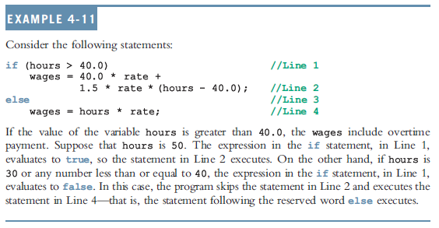
Two-Way Selection (cont'd.)

Slide 10
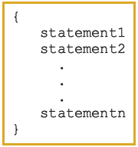
Compound (Block of) Statements
Compound statement (block of statements):
A compound statement is a single statement

Slide 11
Compound (Block of) Statements (cont'd.)
if (age > 18)
{
cout << "Eligible to vote." << endl;
cout << "No longer a minor." << endl;
}
else
{
cout << "Not eligible to vote." << endl;
cout << "Still a minor." << endl;
}

Slide 12
Multiple Selections: Nested if
Nesting: one control statement in another
An else is associated with the most recent if that has not been paired with an else

Slide 13
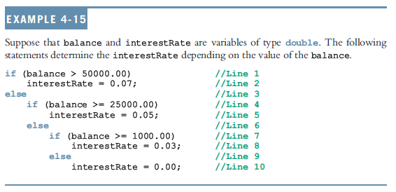
Multiple Selections: Nested if (cont'd.)

Slide 14
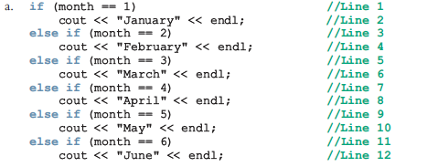
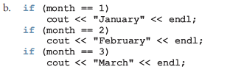

Comparing if…else Statements with a Series of if Statements

Slide 15
Confusion Between the Equality (==) and Assignment (=) Operators
C++ allows you to use any expression that can be evaluated to either true or false as an expression in the if statement:
if (x = 5)
cout << "The value is five." << endl;
The appearance of = in place of == resembles a silent killer
It is not a syntax error
It is a logical error

Slide 16
Conditional Operator (?:)
Conditional operator (?:) takes three arguments
Ternary operator
Syntax for using the conditional operator:
expression1 ? expression2 : expression3
If expression1 is true, the result of the conditional expression is expression2
Otherwise, the result is expression3

Slide 17
switch Structures
switch structure: alternate to if-else
switch (integral) expression is evaluated first
Value of the expression determines which corresponding action is taken
Expression is sometimes called the selector

Slide 18
switch Structures (cont'd.)

Slide 19
switch Structures (cont'd.)
One or more statements may follow a case label
Braces are not needed to turn multiple statements into a single compound statement
The break statement may or may not appear after each statement
switch, case, break, and default are reserved words

Slide 20
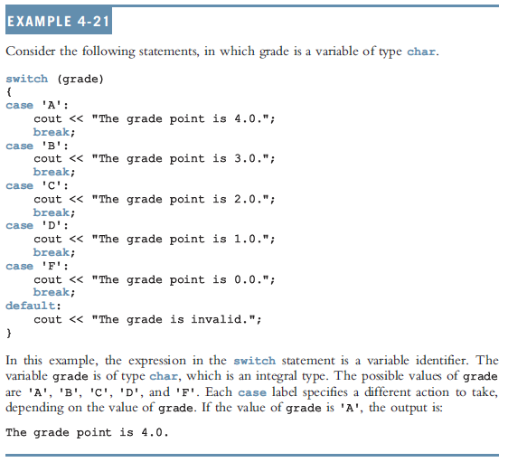
switch Structures (cont'd.)

